Slide 1


Chapter 1
Introduction to PHP
Department of E-Commerce
Faculty of Science and Information Technology
Kolej Universiti Islam Antarabangsa Selangor (KUIS)
http://www.kuis.edu.my/fstm

Slide 2


What is Web programming:
  Combination of server-side and client-side to develop a dynamic website.
  The application is deployed in the Web environment and can be access by multiple concurrent users.
In order to start learning PHP, you should have a basic understanding of HTML first.

Slide 3

PHP= PHP: Hypertext Preprocessor:
  Is a server-side scripting language.
  PHP scripts are executed on the server, and the output from the process is inserted to the Web page as a part of the content before transmitted to the browser.
  The script will not be sent to the browser which request the Web page, so the script is not visible to the users.

Slide 4

PHP is built upon an easy integration of all open source products. The term LAMP is synonym with
PHP= PHP: Hypertext Preprocessor:
  PHP is built upon an easy integration of all open source products.
  The term LAMP is synonym with Linux, Apache, MySQL & PHP.
  Supports many databases (MySQL, Oracle etc.).
  Is an open source software.
  Is free to download and use.
  PHP files have a file extension of .php.

Slide 5

Server-side Scripting | Client-side scripting
The script embedded inside the HTML page, interpreted and executed inside the server (the web server) and the result/output of the execution is sent to the browser. The script interpreted and executed inside the server. E.g.: PHP, ASP. | The script embedded inside the HTML page, downloaded with the HTML page and executed on the client (browser). E.g.: JavaScript.

Slide 6
What is MySQL?
  Is a database server.
  Is ideal for both small and large applications.
  Supports standard SQL.
  Is free to download and use.

Slide 7
PHP + MySQL:
  PHP combined with MySQL are cross-platform (you can develop in Windows and serve on a Unix platform).

Slide 8
Why PHP?
  Runs on different platforms (Windows, Linux, Unix, etc.).
  Is compatible with almost all servers used today (Apache, IIS, etc.).
  Is free to download.
  Is easy to learn and runs efficiently on the server side.

Slide 9

How to start?
  To get access to a Web server with PHP support, you can:
  (1) Install Apache as Web server,
  (2) Install PHP as the server script interpreter, and
  (3) Install MySQL as the database server.
Solution: Install XAMPP.

Slide 10

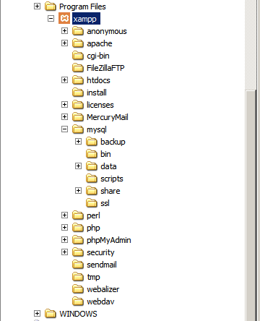
XAMPP application folder:
htdocs – the Web root where we save all the PHP scripts)
mysql/data – where MySQL store the database records
phpMyAdmin – the Web based MySQL administrator

